Slide 1
BOOSTING ALGORITHMS

Slide 2
XGBOOST
XGBoost, or eXtreme Gradient Boosting, is a XGBoost algorithm in machine learning algorithm under ensemble learning.
It is trendy for supervised learning tasks, such as regression and classification.
XGBoost builds a predictive model by combining the predictions of multiple individual models, often decision trees, in an iterative manner.

Slide 3
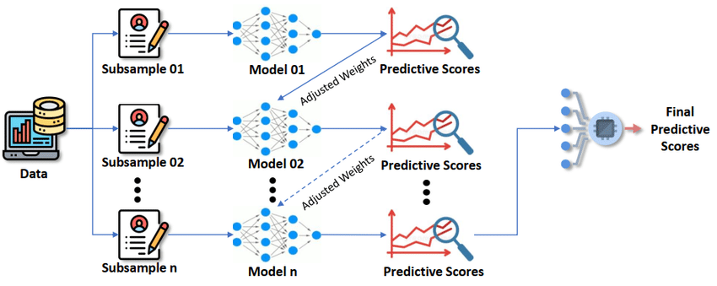

Slide 4
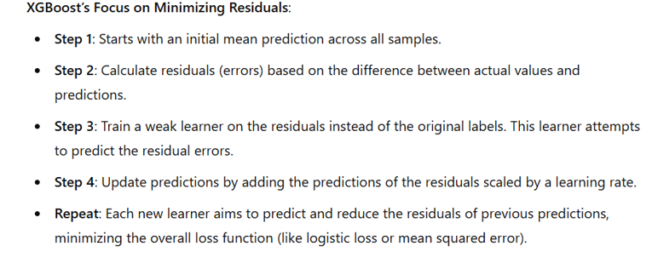

Slide 5
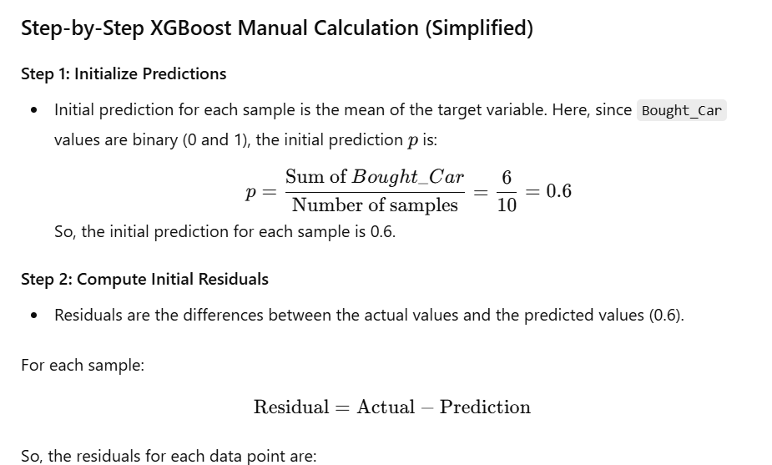

Slide 6
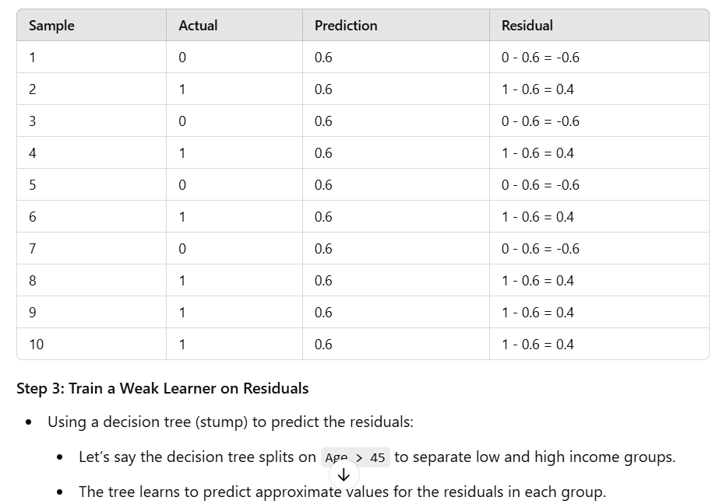

Slide 7
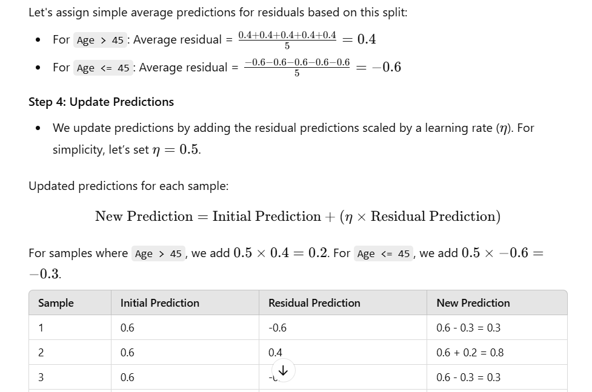

Slide 8
